Slide 1

Car Price Prediction
Project by:
MAYURESH V PATIL

Slide 2
Agenda:
Introduction
Data Collection
Data Cleaning
Exploratory Data Analysis
Predicting Model

Slide 3
Project Overview
Problem Definition:
Used cars sales are on global increase. There is a need for car price prediction system to effectively determine business finance and customer purchase
Solution:
*A model can be developed to predict and assign that price too the vehicle
*To effectively determine the worthiness of car by studying variety of features
Results:
*To predicts the actual market value considering various characteristics that helps both buyers and sellers

Slide 4
Introduction
Determining whether the listed price of a used car is a challenging task, due to the many factors that drive a used vehicle’s price on the market
The focus of this project is developing machine learning models that can accurately predict the price of a used car based on its features, in order to make informed purchases.
We implement and evaluate various learning methods on a dataset consisting of the sale prices of different makes and models across cities in the United States.
Conventional linear regression also yielded satisfactory results, with the advantage of a significantly lower training time in comparison to the aforementioned methods.

Slide 5
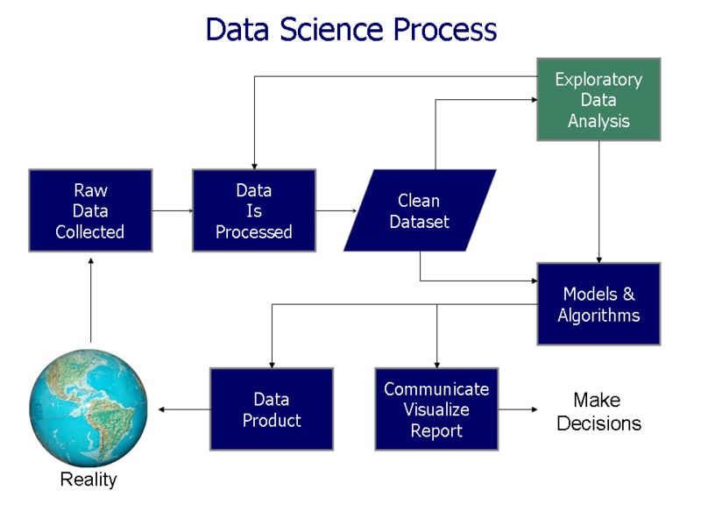
Data Collection: * For accurate and real time analysis ,data is prepared from scratch * Data is scrapped from kaggle ‘cars dataset ’

Slide 6
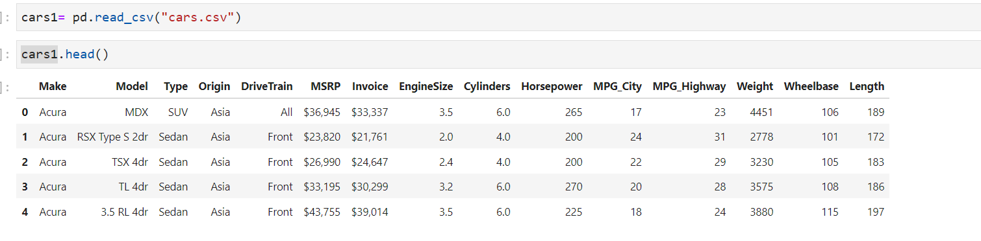
Sample Dataset

Slide 7
Data Cleaning
Data cleaning is one of the important parts of machine learning. It plays a significant part in building a model. It surely isn’t the fanciest part of machine learning and at the same time, there aren’t any hidden tricks or secrets to uncover. However, the success or failure of a project relies on proper data cleaning. Professional data scientists usually invest a very large portion of their time in this step because of the belief that “Better data beats fancier algorithms”. If we have a well-cleaned dataset, there are chances that we can get achieve good results with simple algorithms also, which can prove very beneficial at times especially in terms of computation when the dataset size is large

Slide 8
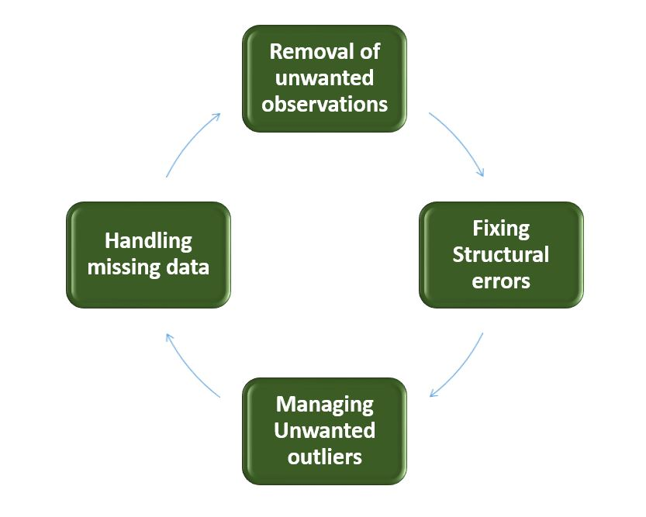
Data Cleaning:

Slide 9
Exploratory data analysis
In order to get a better understanding of the data, we plotted a histogram of the data. We noticed that the dataset had many outliers, primarily due to large price sensitivity of used cars. Typically, models that are the
latest year and have low mileage sell for a premium, however, there were many data points that did not conform to this. This is because accident history and condition can have a significant effect on the car’s price.
Since we did not have access to vehicle history and condition, we pruned our dataset to three standard deviations around the mean in order to remove outliers.

Slide 10
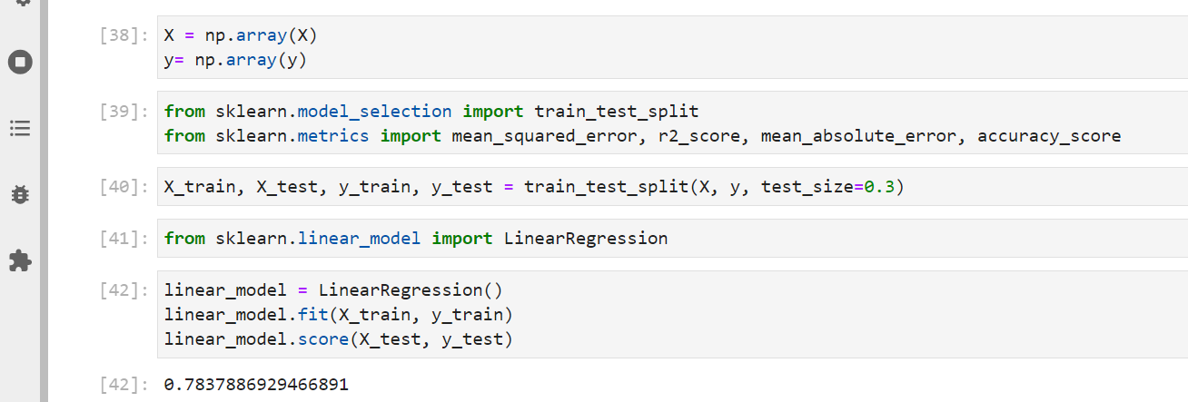
Machine Learning Predicting Model:
Linear Regression model

Slide 11
Results:
The sign of a linear regression coefficient tells you whether there
is a positive or negative correlation between each independentvariable and the dependent variable.

